Slide 1



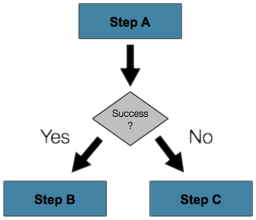

C#: Conditional Statements and Loops
Implementing Control-Flow Logic, Conditions and Loops in C#
Conditions
and Loops
SoftUni Team
Technical Trainers
Software University
http://softuni.bg

Slide 2



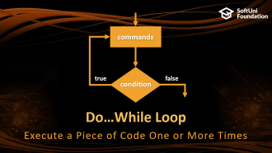

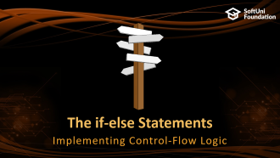
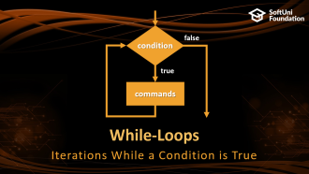
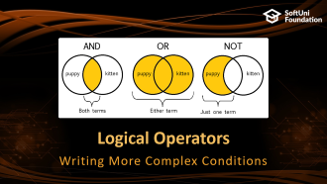
Table of Contents

Slide 3
Have a Question?
sli.do #fund-softuni

Slide 4

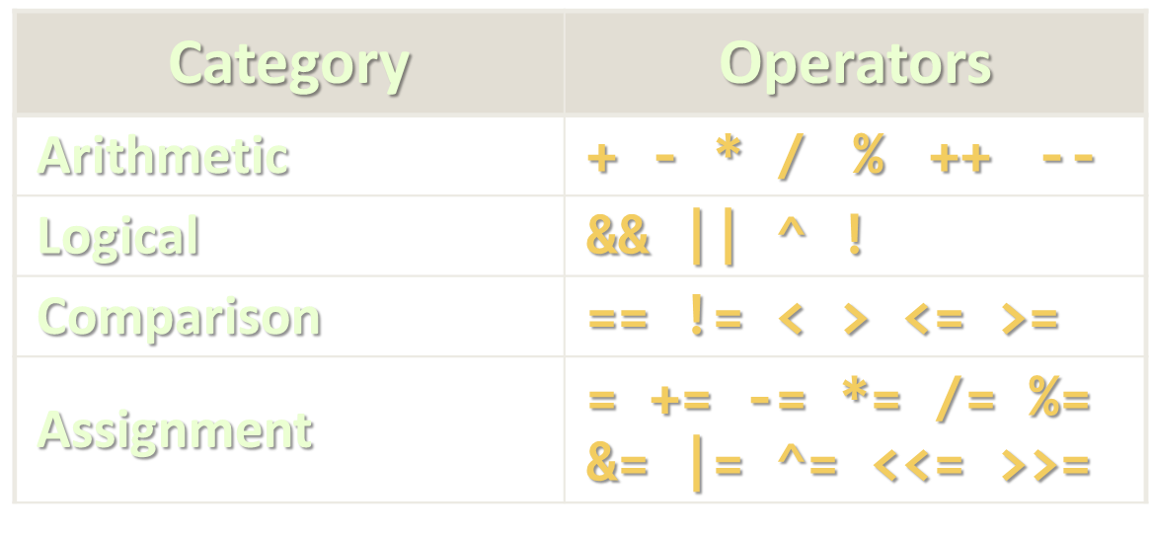
Comparison Operators

Slide 5
Comparing Numbers
Values can be compared in C# like in any other language:
var a = 5;
var b = 10;
Console.WriteLine(a < b); // True
Console.WriteLine(a > 0); // True
Console.WriteLine(a > 100); // False
Console.WriteLine(a < a); // False
Console.WriteLine(a <= 5); // True
Console.WriteLine(b == 2 * a); // True
Operator < (less than)
Operator > (greater than)
Operator <= (less or equal)
Operator == (equal)

Slide 6
Comparison Operators
Operator | Notation in C# | Applicable for
Equals | == | strings / numbers / dates / most objects
Not Equals | !=
Greater Than | > | numbers / dates / comparable objects
Greater Than or Equals | >=
Less Than | <
Less Than or Equals | <=
Example:
bool result = (5 <= 6);
Console.WriteLine(result); // True

Slide 7
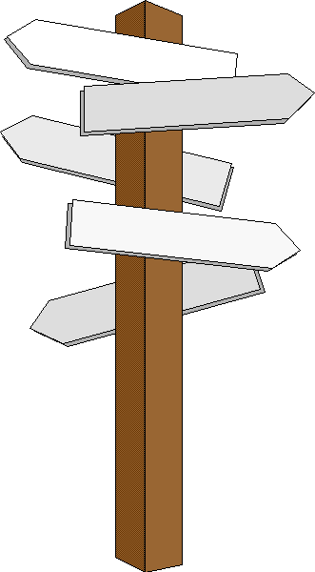
The if-else Statements
Implementing Control-Flow Logic

Slide 8
The if Statement
The most simple conditional statement
Test for a condition
Example: take as an input a grade and check if the student passed the exam (grade >= 3.00):
var grade = double.Parse(Console.ReadLine());
if (grade >= 3.00)
{
Console.WriteLine("Passed!");
}
In C# the opening bracket stays on a new line
Check your solution here: https://judge.softuni.bg/Contests/563

Slide 9
The if-else Statement
Executes one branch if the condition is true and another, if it is false
Example: Upgrade the last example, so it prints "Failed!", if the mark is lower than 3.00:
if (grade >= 3.00)
{
Console.WriteLine("Passed!");
}
else
{
// TODO: Print the message
}
The else keyword stays on a new line
Check your solution here: https://judge.softuni.bg/Contests/563

Slide 10
Problem: I Will be Back in 30 Minutes
Write a program that reads hours and minutes from the console and calculates the time after 30 minutes
The hours and the minutes come on separate lines
Example:
1
46
2:16
0
01
0:31
23
59
0:29
11
08
11:38
12
49
13:19
11
32
12:02
Check your solution here: https://judge.softuni.bg/Contests/563

Slide 11
Solution: I Will be Back in 30 Minutes
int hours = int.Parse(Console.ReadLine());
int minutes = int.Parse(Console.ReadLine()) + 30;
if (minutes > 59)
{
hours += 1;
minutes -= 60;
}
// Continue on the next slide
Check your solution here: https://judge.softuni.bg/Contests/563

Slide 12
Solution: I Will be Back in 30 Minutes (2)
if (hours > 23)
{
hours = 0;
}
if (minutes < 10)
{
Console.WriteLine("{0}:{1:D2}", hours, minutes);
}
else
{
Console.WriteLine("{0}:{1}", hours, minutes);
}
Check your solution here: https://judge.softuni.bg/Contests/563

Slide 13

The Switch-Case Statement
Simplified if-else-if-else

Slide 14
The switch-case Statement
Works as sequence of if-else statements
Example: read input a number and print its corresponding month:
var month = int.Parse(Console.ReadLine());
switch (month)
{
case 1: Console.WriteLine("January"); break;
case 2: Console.WriteLine("February"); break;
// TODO: Add the other cases
case 12: Console.WriteLine("December"); break;
default: Console.WriteLine("Error!"); break;
}
Check your solution here: https://judge.softuni.bg/Contests/563

Slide 15
Problem: Foreign Languages
By given country print its typical language: English -> England, USA; Spanish -> Spain, Argentina, Mexico; other -> unknown
switch (country)
{
case "USA":
case "England": Console.WriteLine("English"); break;
case "Spain":
case "Argentina":
case "Mexico": Console.WriteLine("Spanish"); break;
default: Console.WriteLine("unknown"); break;
}
Check your solution here: https://judge.softuni.bg/Contests/563

Slide 16
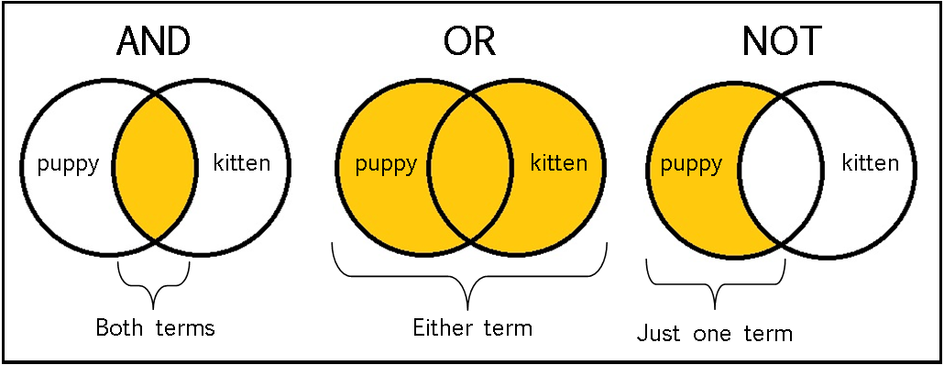
Logical Operators
Writing More Complex Conditions

Slide 17
Logical Operators
Operator | Notation in C# | Example
Logical NOT | ! | !false -> true
Logical AND | && | true && false -> false
Logical OR | || | true || false -> true
Logical operators give us the ability to write multiple conditions in one if statement
They return a boolean value and compare boolean values

Slide 18
Problem: Theatre Promotions
A theatre has the following ticket prices according to the age of the visitor and the type of day. If the age is < 0 or > 122, print "Error!":
Day / Age | 0 <= age <= 18 | 18 < age <= 64 | 64 < age <= 122
Weekday | 12$ | 18$ | 12$
Weekend | 15$ | 20$ | 15$
Holiday | 5$ | 12$ | 10$
Write a program to calculate the price for a single customer
Weekday
42
18$
Holiday
-12
Error!
Check your solution here: https://judge.softuni.bg/Contests/563

Slide 19
Solution: Theatre Promotion
var day = Console.ReadLine().ToLower();
var age = int.Parse(Console.ReadLine());
var price = 0;
if (day == "weekday")
{
if ((age >= 0 && age <= 18) || (age > 64 && age <= 122))
{
price = 12;
}
// TODO: Add else statement for the other group
}
// Continues on the next slide
Check your solution here: https://judge.softuni.bg/Contests/563

Slide 20
Solution: Theatre Promotion (2)
else if (day == "weekend")
{
if ((age >= 0 && age <= 18) || (age > 64 && age <= 122))
{
price = 15;
}
else if (age > 18 && age <= 64)
{
price = 20;
}
}
// Continue on the next slide
Check your solution here: https://judge.softuni.bg/Contests/563

Slide 21
Solution: Theatre Promotion (3)
else if (day == "holiday")
{
if (age >= 0 && age <= 18)
{
price = 5;
}
// TODO: Add the statements for the other cases
}
// Continue on the next slide
Check your solution here: https://judge.softuni.bg/Contests/563

Slide 22
Solution: Theatre Promotion (4)
if (price != 0)
{
Console.WriteLine(price + "$");
}
else
{
Console.WriteLine("Error!");
}
Check your solution here: https://judge.softuni.bg/Contests/563

Slide 23

Loops
Repeating a Piece of Code Multiple Times

Slide 24
Loop: Definition
A loop is a control statement that repeats the execution of a block of statements. The loop can:
Execute a code block a fixed number of times
for loop
Execute a code block while a given condition returns true
while
do…while
In C# we have all of the above types of loops

Slide 25

For-Loops
for-loops
Managing the Count of the Iteration

Slide 26
For-Loops
The for loop executes statements a fixed number of times:
Initial value
End value
Increment
for (var i = 1; i <= 10; i++)
{
Console.WriteLine("i = " + i);
}
Loop body
Executed at each iteration
The bracket is again at the new line

Slide 27

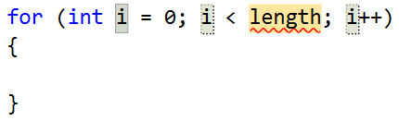
Example: Divisible by 3
Print the numbers from 1 to 100, that are divisible by 3
You can use "for-loop" code snippet in Visual Studio
for (var i = 3; i <= 100; i += 3)
{
Console.WriteLine(i);
}
Push [Tab] twice
Check your solution here: https://judge.softuni.bg/Contests/563

Slide 28
Problem: Sum of Odd Numbers
Write a program to print the first n odd numbers and their sum
1
3
5
7
9
Sum: 25
1
3
5
Sum: 9
5
3
Check your solution here: https://judge.softuni.bg/Contests/563

Slide 29
Solution: Sum of Odd Numbers
var n = int.Parse(Console.ReadLine());
var sum = 0;
for (var i = 1; i <= n; i++)
{
Console.WriteLine("{0}", 2 * i - 1);
sum += 2 * i - 1;
}
Console.WriteLine($"Sum:{sum}");
Check your solution here: https://judge.softuni.bg/Contests/563

Slide 30
While-Loops
false
condition
true
commands
Iterations While a Condition is True

Slide 31
While Loops
Executes commands while the condition is true:
Initial value
Condition
var n = 1;
while (n <= 10)
{
Console.WriteLine(n);
n++;
}
Loop body
Increment the counter

Slide 32
Problem: Multiplication Table
Print a table holding number*1, number*2, …, number*10
var number = int.Parse(Console.ReadLine());
var times = 1;
while (times <= 10)
{
Console.WriteLine(
$"{number} X {times} = {number * times}");
times++;
}
3
3 X 1 = 3
3 X 2 = 6
3 X 3 = 9
3 X 4 = 12
3 X 5 = 15
3 X 6 = 18
3 X 7 = 21
3 X 8 = 24
3 X 9 = 27
3 X 10 = 30
Check your solution here: https://judge.softuni.bg/Contests/563

Slide 33
Do…While Loop
commands
true
false
condition
Execute a Piece of Code One or More Times

Slide 34
Do ... While Loop
Similar to the while loop, but always executes at least once:
Initial value
var i = 1;
do
{
Console.WriteLine(i);
i++;
}
while (i <= 10);
Loop body
Increment the counter
Condition

Slide 35
Problem: Multiplication Table 2.0
Upgrade your program and take the initial times from the console
Print result at least for the first calculation
var number = int.Parse(Console.ReadLine());
var times = int.Parse(Console.ReadLine());
do
{
Console.WriteLine(
$"{number} X {times} = {number * times}");
times++;
} while (times <= 10);
Check your solution here: https://judge.softuni.bg/Contests/563

Slide 36
Handling Errors with Try-Catch
In C# we can catch errors and handle them using custom logic
Write a program to read input from the console and prints its type
Print "It is a number.", if it’s a number
Print "Invalid input!" otherwise
5
It is a number.
five
Invalid input!
Check your solution here: https://judge.softuni.bg/Contests/563

Slide 37
Solution: Number Checker
try
{
var n = int.Parse(Console.ReadLine());
Console.WriteLine("It is a number.");
}
catch (NumberFormatException)
{
Console.WriteLine("Invalid input!");
}
Exception type
Check your solution here: https://judge.softuni.bg/Contests/563

Slide 38

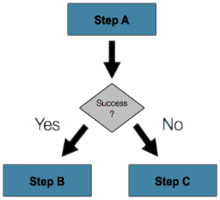
Summary
If-statements in C# are like in Java, JS, C++, …
Loops in C# are like in Java, JS, C++, …
The bracket in C# is stays at the new line
The break keyword exits the innermost loop
Exceptions are runtime errors
The try-catch statement catches exceptions and executes custom logic

Slide 39







Programming Fundamentals – Course Overview
https://softuni.bg/courses/programming-fundamentals

Slide 40
License
This course (slides, examples, demos, videos, homework, etc.) is licensed under the "Creative Commons Attribution-NonCommercial-ShareAlike 4.0 International" license

Slide 41





Trainings @ Software University (SoftUni)
Software University – High-Quality Education, Profession and Job for Software Developers
softuni.bg
Software University Foundation
http://softuni.foundation/
Software University @ Facebook
facebook.com/SoftwareUniversity
Software University Forums
forum.softuni.bg

